Slide 1
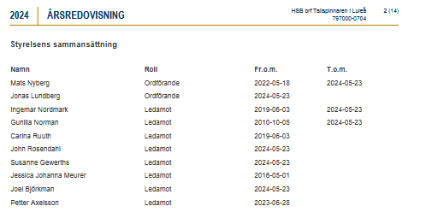
Jonas Lundberg Ledamot 2023-06-28 2024-05-23
2004-04-28
2005-04-11
2002-03-19

